Slide 1

ALY 6060
Week 3

Slide 2
Feedback on Homework
Citations needed
Do not cut and paste other people’s words into your document as if they were your own words
Everything in reference list must be cited
Don’t number your paragraphs.
Don’t format paper as a series of questions and answers
Address all points in the assignment

Slide 3
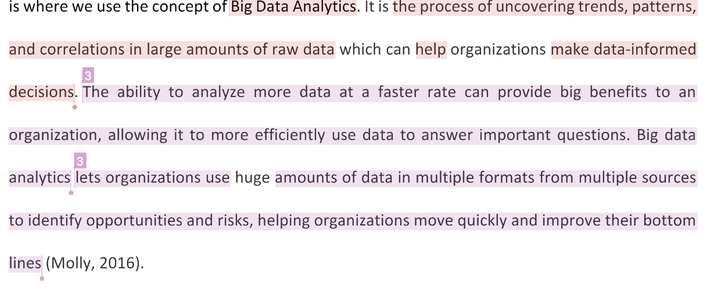

Slide 4
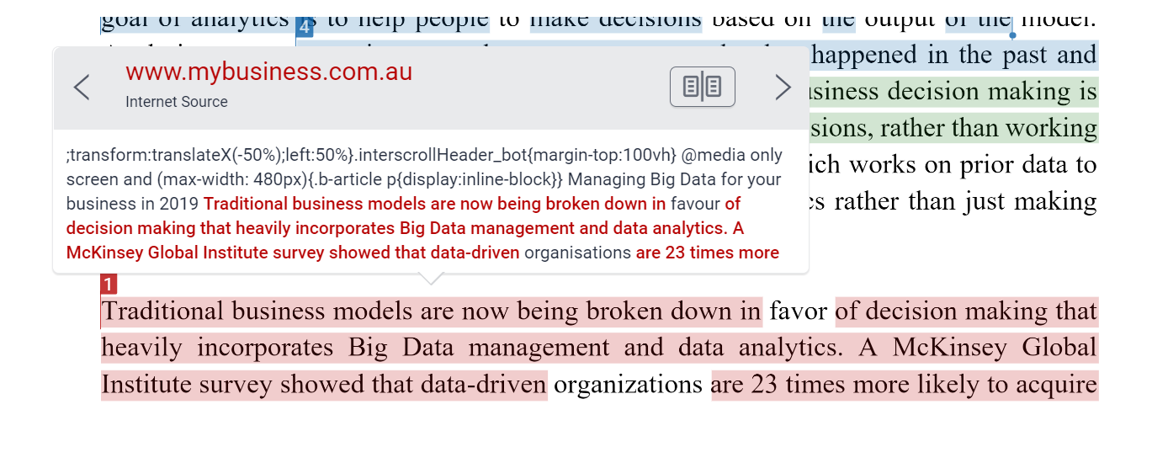

Slide 5
Business Intelligence
A broad category of applications, services, and technologies for gathering, storing, analyzing, and accessing data for decision-making
A set of independent systems that aggregate data from multiple sources, prepare the data for analysis, and then provide reporting and analysis on that data from a central viewpoint.
Some common BI tools: Python, Qlik Sense, Tableau, Bold B, IBM Watson Analytics, Power BI
Traditionally, BI requires users to leave their workflow applications to look at data insights in a separate set of tools
https://www.logianalytics.com/bi-trends/what-is-embedded-analytics/

Slide 6
BI vs. “Embedded Analytics”
What do you know about Embedded Analytics?

Slide 7
Activity
Read “Top embedded analytics examples in enterprise analytics”
Answer the question:
What is embedded analytics, and how is it different from traditional BI?

Slide 8
Embedded Analytics
Embedded analytics is the technology designed to make data analysis and business intelligence more accessible by any application or user.
Embedded analytics software delivers real-time reporting, interactive data visualization and/or advanced analytics, including machine learning, directly into an enterprise business application.^{[3]} The data is managed by an analytics platform, and the visualizations and reports are placed directly within the application user interface.^{[3]}
This immediacy makes embedded analytics much more intuitive and likely to be viewed by users.^{[5]} A December 2016 report from Nucleus Research found that using BI tools, which require toggling between applications, can take up as much as 1-2 hours of an employee’s time each week, whereas embedded analytics eliminate the need to toggle between apps.^{[6]}
Enables fast, data-driven decision making.
https://en.wikipedia.org/wiki/Embedded_analytics

Slide 9
Signature Assignment
See instructions and rubric in Week 3 module in Canvas
Review expectations

Slide 10
Week 3 Tasks
No homework assignment to submit, but…
The focus of this week addresses a required item in the Signature Assignment—
The role of models, user interface, culture, and design in a quality DSS/BI/embedded analytics system
You will identify these features during class time for future use in your Signature Assignment

Slide 11
Chapter Questions
CH. 4: What is a model? How are models and analytics related? How are they different? How can a designer improve the users' understanding of results of a model in a DSS?
CH. 5: What is the user interface of a DSS, and why is it important? How would you evaluate the user interface of a DSS?
CH. 6: What guidelines would you provide to a designer of a transnational DSS to help him or her be more sensitive to the needs of decision makers in all countries? In particular, what aspects of the system are most likely to be affected by the transnational nature of the system? How?
CH. 7: Identify the critical success factors associated with DSS design. How would designers evaluate these factors prior to beginning a project?

Slide 12
Activity
Pairs of students will be formed
Each pair will be assigned one question
Each pair will craft a well-articulated response of no more than 2500 characters (approximately 400-500 words)
Use Google Doc or another collaborative tool to work together
Post the response at: https://www.research.net/r/KYV9YW6 by the end of class time
Responses will be evaluated for completeness, clarity, and originality and will count toward class participation for the week
After class, responses to all of the questions will be shared with all students
Use these responses as a resource for your Signature Assignment

